Slide 1
CSE322
Regular Expressions and their Identities
Lecture #6

Slide 2
Regular Expressions
The language accepted by finite automata can be easily described by simple expressions called Regular Expressions. It is the most effective way to represent any language.
The languages accepted by some regular expression are referred to as Regular languages.
A regular expression can also be described as a sequence of pattern that defines a string.
Regular expressions are used to match character combinations in strings. String searching algorithm used this pattern to find the operations on a string.

Slide 3
In a regular expression, x* means zero or more occurrence of x. It can generate {e, x, xx, xxx, xxxx, .....}
In a regular expression, x⁺ means one or more occurrence of x. It can generate {x, xx, xxx, xxxx, .....}

Slide 4
Regular Expressions
We give a formal recursive definition of regular expressions over ∑ as follows:
1. Any terminal symbol (i.e. an element of ∑), Λ and ∅ are regular
expressions. When we view a in ∑ as a regular expression, we denote it by a.
2. The union of two regular expressions R1and R2 , written as R 1 + R2, is also a regular expression.
3. The concatenation of two regular expressions R1and R2, written as
R1 R2, is also a regular expression.
4. The iteration (or closure) of a regular expression R written as R*, is
also a regular expression.
5.If R is a regular expression, then (R) is also a regular expression.
6. The regular expressions over∑ are precisely those obtained
recursively by the application of the rules 1-5 once or several times

Slide 5
Definitions
Any set represented by a regular expression is called a regular set.
If for example, a, b ε ∑. Then
(i) a denotes the set {a},
(ii) a + b denotes {a, b},
(iii) ab denotes {ab},
(iv) a* denotes the set {lambda, a, aa. aaa, ... } and
(v) (a + b)* denotes {a, b}*. The set represented by R is denoted by L(R),
Notes:
Definitions

Slide 6
Questions
Describe the following sets by regular expressions:
{101}
{abba}
{01,10}
{Λ ,ab}
{abb,a, b, bba}
{Λ , 0, 00, 000.... }
{1, 11, 111 ... }

Slide 7
Solution
(a) Now. {1}. {O} are represented by 1 and O. respectively. 101 is obtained
by concatenating 1,0 and 1 So. {10 I} is represented by 101.
(b) abba represents {abba}.
(c) As {01, 10} is the union of {01} and {10}, we have {01, 10}
represented by 01 + 10
(d) The set {Λ , ab} is represented by Λ + ab
(e) The set {abb, a, b, bba} is represented by abb + a + b + bba.
f) As {Λ , 0, 00, 000, ... } is simply {O}*. it is represented by 0*
(g) Any element in {1, 11, 111, ... } can be obtained by concatenating
1 and any element of {1}*. Hence 1(1)* represents {1, 11, 111, ... }

Slide 8
Example 1:
Write the regular expression for the language accepting all combinations of a's, over the set ∑ = {a}

Slide 9
Example 1:
Write the regular expression for the language accepting all combinations of a's, over the set ∑ = {a}
Solution:
All combinations of a's means a may be zero, single, double and so on. If a is appearing zero times, that means a null string. That is we expect the set of {ε, a, aa, aaa, ....}. So we give a regular expression for this as:
R = a*
That is Kleen closure of a.

Slide 10
Example 2:
Write the regular expression for the language accepting all combinations of a's except the null string, over the set ∑ = {a}

Slide 11
Example 2:
Write the regular expression for the language accepting all combinations of a's except the null string, over the set ∑ = {a}
Solution:
  The regular expression has to be built for the language
  L = {a, aa, aaa, ....}
  This set indicates that there is no null string. So we can denote regular expression as:
  R = a⁺

Slide 12
Example 3:
Write the regular expression for the language accepting all the string containing any number of a's and b's.

Slide 13
Example 3:
Write the regular expression for the language accepting all the string containing any number of a's and b's.
Solution:
  The regular expression will be:
  r.e. = (a + b)*
  This will give the set as L = {ε, a, aa, b, bb, ab, ba, aba, bab, .....}, any combination of a and b.
  The (a + b)* shows any combination with a and b even a null string.

Slide 14
Example 4
Write the regular expression for the language accepting all the string which are starting with 1 and ending with 0, over ∑ = {0, 1}.

Slide 15
Example 4
Write the regular expression for the language accepting all the string which are starting with 1 and ending with 0, over ∑ = {0, 1}.
Solution:
  In a regular expression, the first symbol should be 1, and the last symbol should be 0. The r.e. is as follows:
  R = 1 (0+1)* 0

Slide 16
Example 5
Write the regular expression for the language starting and ending with a and having any having any combination of b's in between.

Slide 17
Example 5
Write the regular expression for the language starting and ending with a and having any having any combination of b's in between.
Solution:
  The regular expression will be:
  R = a b* b

Slide 18
Example 6
Write the regular expression for the language starting with a but not having consecutive b's.

Slide 19
Example 6
Write the regular expression for the language starting with a but not having consecutive b's.
  Solution:
  The regular expression has to be built for the language:
  L = {a, aba, aab, aba, aaa, abab, .....}
  The regular expression for the above language is:
  R = {a + ab}*

Slide 20
Example 7
Write the regular expression for the language accepting all the string in which any number of a's is followed by any number of b's is followed by any number of c's.

Slide 21
Example 7
Write the regular expression for the language accepting all the string in which any number of a's is followed by any number of b's is followed by any number of c's.
Solution:
As we know, any number of a's means a* any number of b's means b*, any number of c's means c*. Since as given in problem statement, b's appear after a's and c's appear after b's. So the regular expression could be:
R = a* b* c*

Slide 22
Example 8
Write the regular expression for the language over ∑ = {0} having even length of the string.

Slide 23
Example 8
Write the regular expression for the language over ∑ = {0} having even length of the string.
Solution:
The regular expression has to be built for the language:
L = {ε, 00, 0000, 000000, ......}
The regular expression for the above language is:
R = (00)*

Slide 24
Example 9
Write the regular expression for the language having a string which should have atleast one 0 and alteast one 1.

Slide 25
Example 9
Write the regular expression for the language having a string which should have atleast one 0 and alteast one 1.
Solution:
The regular expression will be:
R = [(0 + 1)* 0 (0 + 1)* 1 (0 + 1)*] + [(0 + 1)* 1 (0 + 1)* 0 (0 + 1)*]

Slide 26
Describe the language denoted by following regular expression
RE. = (b* (aaa)* b*)*

Slide 27
Describe the language denoted by following regular expression
RE. = (b* (aaa)* b*)*
The language can be predicted from the regular expression by finding the meaning of it. We will first split the regular expression as:
r.e. = (any combination of b's) (aaa)* (any combination of b's)
L = {The language consists of the string in which a's appear triples, there is no restriction on the number of b's}

Slide 28
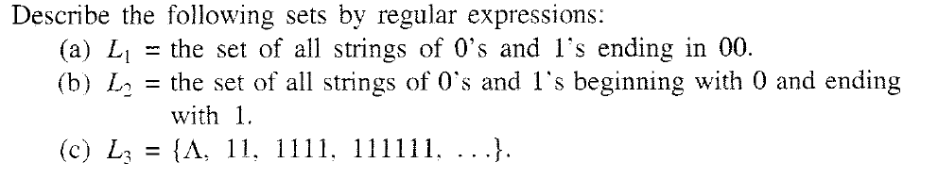
Problem

Slide 29
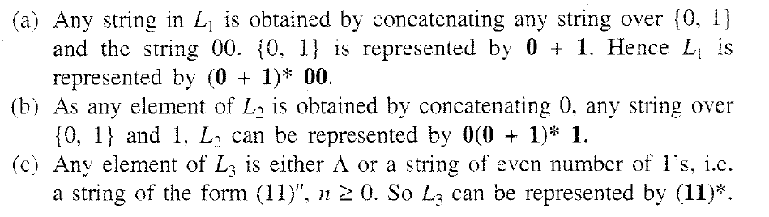
Solution

Slide 30
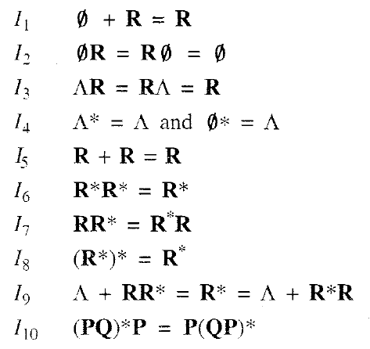

`
IDENTITIES FOR REGULAR EXPRESSIONS
Notes:
IDENTITIES FOR REGULAR EXPRESSIONS

Slide 31
THEORM
Theorem :
(Arden' s theorem) Let P and Q be two regular expressions over ∑. If P does not contain Λ, then the following equation in R, namely
R = Q + RP
has a unique solution (i.e. one and only one solution) given by R = QP*.

Slide 32
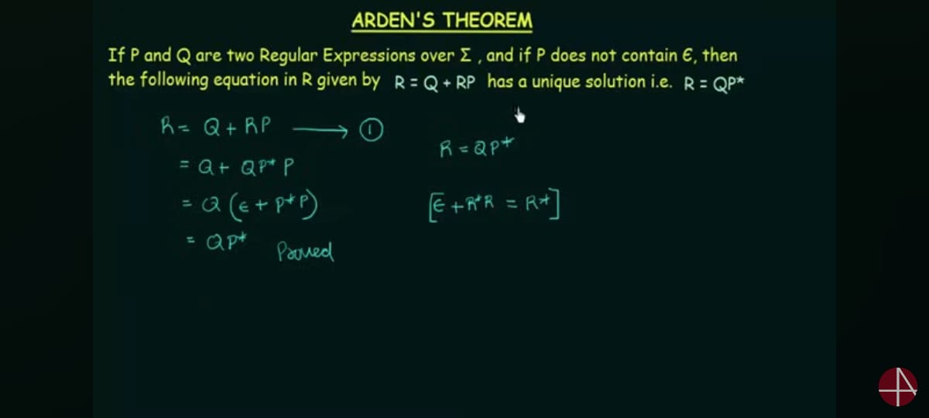
Ardens Theorem

Slide 33
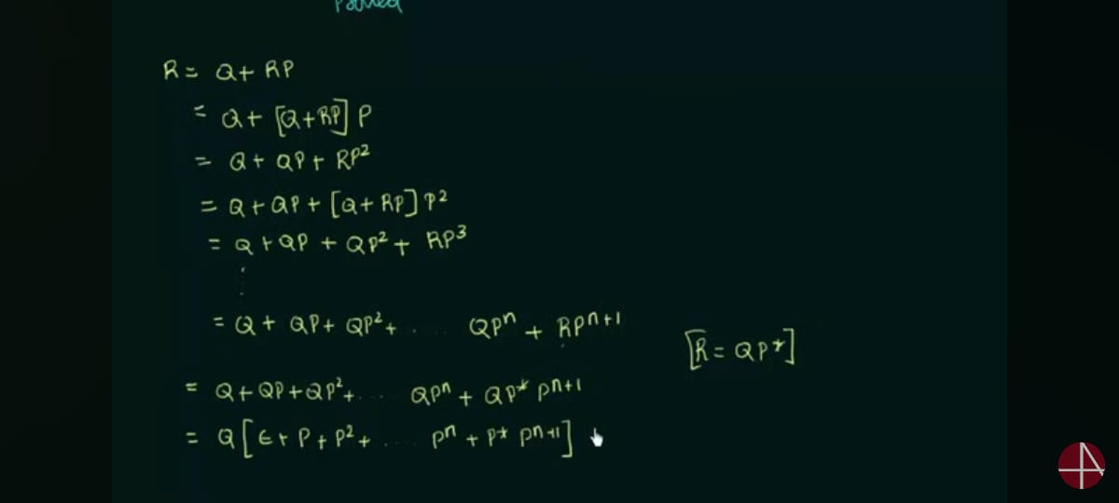

Slide 34
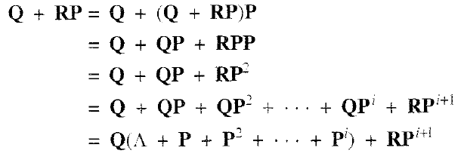
THEORM
Proof
Q + (QP*)P = Q(Λ+ P*P) = QP* by I9

Slide 35
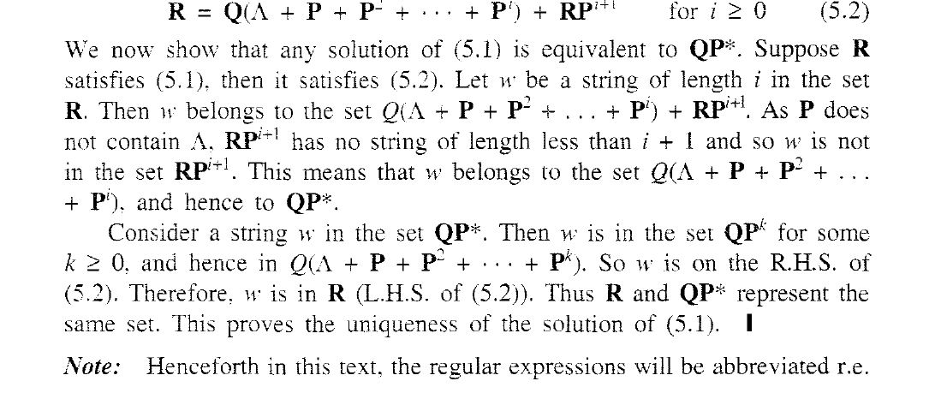
Important justification

Slide 36
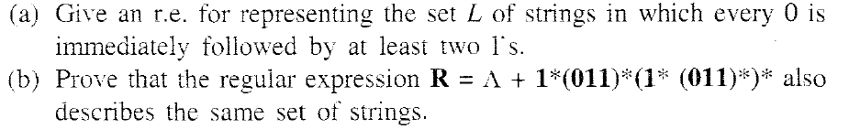
PROBLEM

Slide 37
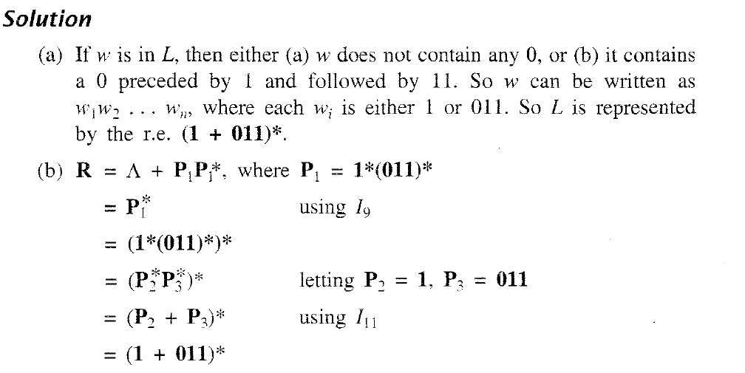
SOLUTION

Slide 38
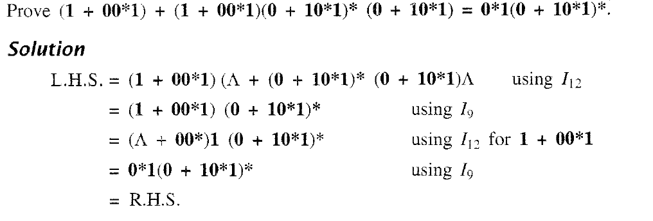
PROBLEM & SOLUTION

Slide 39

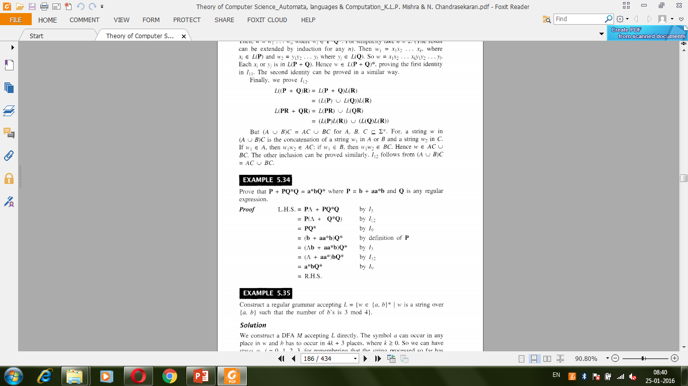

Slide 41
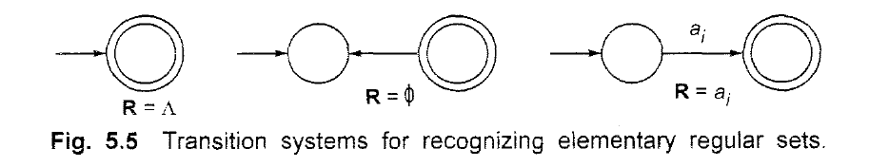
Difference between Null and Ø

Slide 42
TRANSITION SYSTEM CONTAINING Λ -MOVES
Suppose we want to replace a Λ -move from vertex V1 to vertex V2' Then
we proceed as follows:
Step 1- Find all the edges starting from V2.
Step 2- Duplicate all these edges starting from V1' without changing the edge
labels.
Step 3- If V1 is an initial state, make V2 also as initial state.
Step 4- If V2 is a final state. make V1 also as the final state.

Slide 43
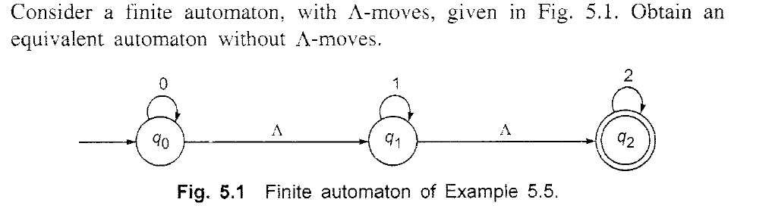
EXAMPLE

Slide 44
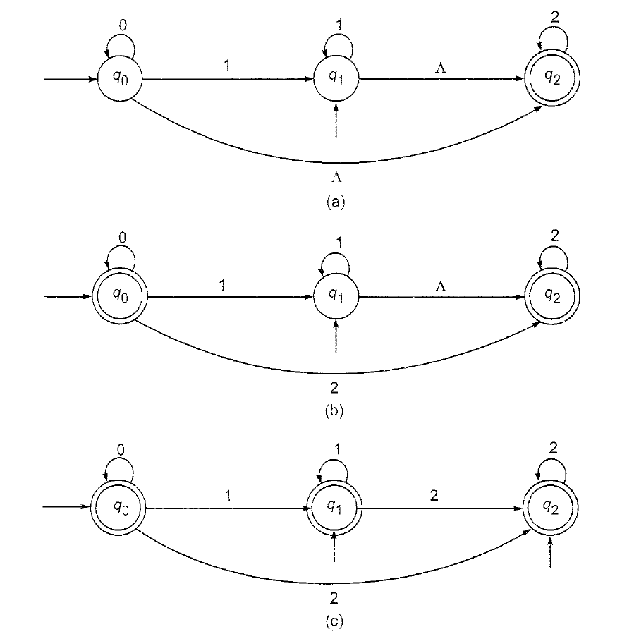
EXAMPLE

Slide 45
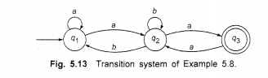
Construct RE from given FA

Slide 46
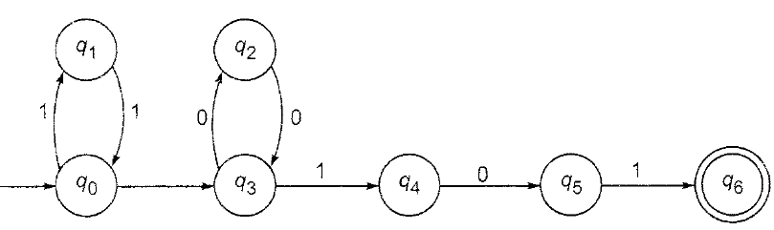
Convert this automata with null moves to automata without it

Slide 47
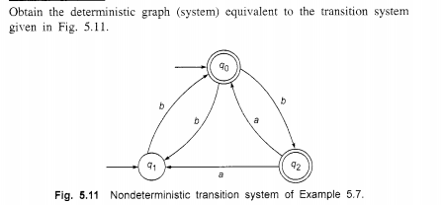

Slide 48
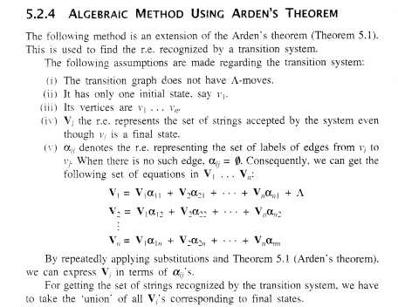

Slide 49
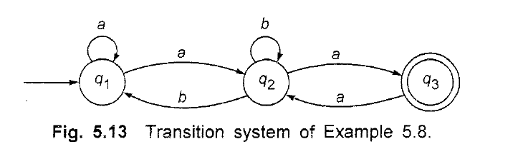
Construct RE from Finite Automata

Slide 50
answer
(a + a(b + aa)*b)*a(b + aa)*a

Slide 51
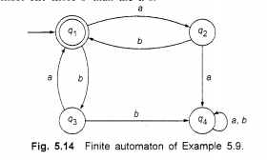
Construct RE from given DFA

Slide 52
Answer
(ab + ba)*

Slide 53
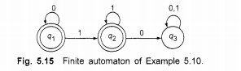
Construct RE from given DFA, take q1 as initial state

Slide 54
Answer
0*(1*)

Slide 55
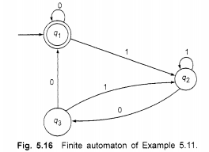
Construct RE from given DFA

Slide 56
Answer
(0 + 1(1 + 01)* 00)*

Slide 57
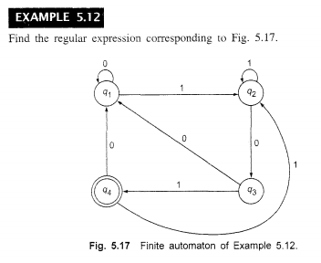
Construct RE from given DFA
Q1 as initial state

Slide 58
(0 + 1(1 + 011)*(00 + 010)*(1(1 + 011)* 01)

Slide 59
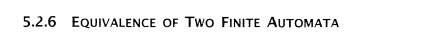
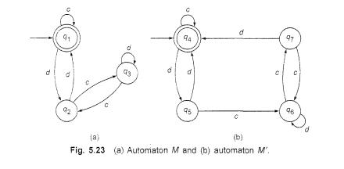

Slide 60
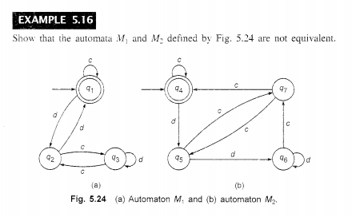

Slide 61
Closure properties of regular sets
Property 1. The union of two regular set is regular.
Proof −
Let us take two regular expressions
RE₁ = a(aa)* and RE₂ = (aa)*
So, L₁ = {a, aaa, aaaaa,.....} (Strings of odd length excluding Null)
and L₂ ={ ε, aa, aaaa, aaaaaa,.......} (Strings of even length including Null)
L₁ ∪ L₂ = { ε, a, aa, aaa, aaaa, aaaaa, aaaaaa,.......}
(Strings of all possible lengths including Null)
RE (L₁ ∪ L₂) = a* (which is a regular expression itself)
Hence, proved.

Slide 62
Closure properties of regular sets
Property 2. The intersection of two regular set is regular.
Proof −
Let us take two regular expressions
RE₁ = a(a*) and RE₂ = (aa)*
So, L₁ = { a,aa, aaa, aaaa, ....} (Strings of all possible lengths excluding Null)
L₂ = { ε, aa, aaaa, aaaaaa,.......} (Strings of even length including Null)
L₁ ∩ L₂ = { aa, aaaa, aaaaaa,.......} (Strings of even length excluding Null)
RE (L₁ ∩ L₂) = aa(aa)* which is a regular expression itself.
Hence, proved.

Slide 63
Closure properties of regular sets
Property 3. The complement of a regular set is regular.
Proof −
Let us take a regular expression −
RE = (aa)*
So, L = {ε, aa, aaaa, aaaaaa, .......} (Strings of even length including Null)
Complement of L is all the strings that is not in L.
So, L’ = {a, aaa, aaaaa, .....} (Strings of odd length excluding Null)
RE (L’) = a(aa)* which is a regular expression itself.
Hence, proved.

Slide 64
Closure properties of regular sets
Property 4. The difference of two regular set is regular.
Proof −
Let us take two regular expressions −
RE₁ = a (a*) and RE₂ = (aa)*
So, L₁ = {a, aa, aaa, aaaa, ....} (Strings of all possible lengths excluding Null)
L₂ = { ε, aa, aaaa, aaaaaa,.......} (Strings of even length including Null)
L₁ – L₂ = {a, aaa, aaaaa, aaaaaaa, ....}
(Strings of all odd lengths excluding Null)
RE (L₁ – L₂) = a (aa)* which is a regular expression.

Slide 65
Closure properties of regular sets
Property 5. The reversal of a regular set is regular.
Proof −
We have to prove L^{R} is also regular if L is a regular set.
Let, L = {01, 10, 11, 10}
RE (L) = 01 + 10 + 11 + 10
L^{R} = {10, 01, 11, 01}
RE (L^{R}) = 01 + 10 + 11 + 10 which is regular
Hence, proved.
Property 6. The closure of a regular set is regular.
Proof −
If L = {a, aaa, aaaaa, .......} (Strings of odd length excluding Null)
i.e., RE (L) = a (aa)*
L* = {a, aa, aaa, aaaa , aaaaa,……………} (Strings of all lengths excluding Null)
RE (L*) = a (a)*
Hence, proved.

Slide 66
Closure properties of regular sets
Property 7. The concatenation of two regular sets is regular.
Proof −
Let RE₁ = (0+1)*0 and RE₂ = 01(0+1)*
Here, L₁ = {0, 00, 10, 000, 010, ......} (Set of strings ending in 0)
and L₂ = {01, 010,011,.....} (Set of strings beginning with 01)
Then, L₁ L₂ = {001,0010,0011,0001,00010,00011,1001,10010,.............}
Set of strings containing 001 as a substring which can be represented by an RE − (0 + 1)*001(0 + 1)*

Slide 67
Construct DFA Equivalent to regular expression
(0 +1 )*(00 + 11)(0 + 1)*
10 + (0 + 11)0*1

Slide 68
Equivalence of 2 regular expression
Prove (a + b)* =a*(ba*)* by constructing regular expressions

Slide 69
CONSTRUCTION OF A REGULAR GRAMMAR
GENERATING T(M) FOR A GIVEN DFA M
Construct a regular grammar G generating the regular set represented by
P = a*b(a + b)*.

Slide 70
CONSTRUCTION OF A TRANSITION SYSTEM M
ACCEPTING L(G) FOR A GIVEN REGULAR
GRAMMAR G
Let G =({Ao, A1,, {a. b}. P, Ao). where P consists of Ao->aA1,A1->bA1,A1->a,A1->bA0
Construct a transition system M accepting L(G).

Slide 71
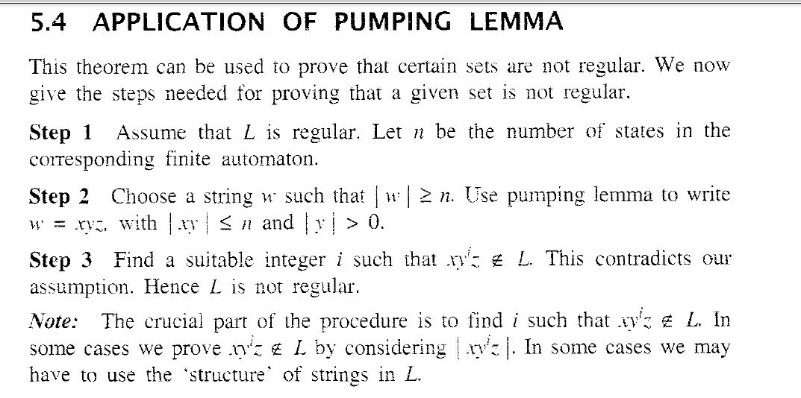
Pumping Lemma

